Slide 1
Rubin Observatory Construction Project Management
Željko Ivezić
University of Washington

Slide 2
DISCLAIMER
I am not the Rubin Obs. Construction Project Manager!!!
This fine fellow is :
Victor Krabbendam, Rubin Observatory Construction Project Manager
and many slides in this deck I stole from him :)

Slide 3
Goals for today
using Rubin Obs. as a study case, to illustrate some aspects of big astronomy projects that are usually skipped in grad school
to familiarize you, as future scientists, with project management aspects of big projects, so that you can better understand and appreciate what project managers do
my goal is *not* (and cannot be) to turn you into project managers in my short 40 mins!
I will emphasize aspects of project management that are interesting to scientists, rather than business-like tools and procedures (of course, some of you may end up as project managers and other project leaders and will have to learn these tools)
I want to give you an opportunity to explore this topic by asking questions; I will go over some basics in under 25 mins, and then we can have a free-form discussion

Slide 4
Outline
1) Introduction
brief introduction to Rubin Observatory and LSST
leadership vs. management
how to build a good team
how to initiate, build and execute a project
2) Brief tour through Project Management
Project Execution Plan and team organization
the importance of communication and documentation
scope, schedule and budget tradeoffs
contingency management
SUMMARY: my “Field guide” to efficient project management
DISCUSSION
DISCUSSION: question? If you like it, jot it down

Slide 5
Every serious project needs project management
This project was not well led or managed…
Thanks to Wil O’Mullane

Slide 6
What is project management?
Project is an undertaking of limited duration, with well defined deliverables (goals and objectives).
Project management is the discipline of managing schedule and resources to deliver on time and budget. In other words, goals and objectives of the project must be achieved within agreed constraints (scope, schedule, budget).
Typically, there is a “reserve” built into planning: the schedule and budget contingencies, as well as descope options, in case the project execution doesn’t go as planned.
"Plans are nothing but planning is everything." (attributed to D. Eisenhower)
"No battle plan survives contact with the enemy” (Sun Tzu)

Slide 7
The difference between leadership and management
▪ Leadership is setting a new direction or vision for a group that they follow, i.e. a leader is the spearhead for that new direction.
▪ Management controls or directs people/resources in a group according to principles or values that have been established.
That is, Vision vs. Implementation...
These are textbook (wikipedia?) definitions. In reality boundaries are fuzzy and often the same individual can perform both roles (with often inconsistent titles, at least in the astronomical community).

Slide 8
The difference between leadership and management
▪ Leadership is setting a new direction or vision for a group that they follow, ie: a leader is the spearhead for that new direction.
▪ Management controls or directs people/resources in a group according to principles or values that have been established.
Many astronomical projects were spearheaded by enthusiastic leaders who invested decades of their life into starting (and finishing!) these projects, e.g.,
Hubble Space Telescope: Lyman Spitzer and John Bahcall
Einstein X-ray Observatory: Riccardo Giacconi
IRAS: Frank Low and Gerry Neugebauer
SDSS: Jim Gunn
LIGO: Barry Barish, Rainer Weiss and Kip Thorne

Slide 9
The difference between leadership and management
▪ Leadership is setting a new direction or vision for a group that they follow, ie: a leader is the spearhead for that new direction.
▪ Management controls or directs people/resources in a group according to principles or values that have been established.
Many astronomical projects were spearheaded by enthusiastic leaders who invested decades of their life into starting (and finishing!) these projects, e.g.,
Hubble Space Telescope: Lyman Spitzer and John Bahcall
Einstein X-ray Observatory: Riccardo Giacconi
IRAS: Frank Low and Gerry Neugebauer
SDSS: Jim Gunn
LIGO: Barry Barish, Rainer Weiss and Kip Thorne
DISCUSSION: are top leaders and managers born or trained? Nature or nurture?

Slide 10
How to become a leader/manager?
Ability to lead and manage can be improved by:
- developing domain (specialist) knowledge
adopting some basic management tools and methods (tracking tools, communication tools, etc)
improved understanding of group dynamics and psychology (“Is it better to have an army of chickens led by a lion, or an army of lions led by a chicken?”)
drawing on past successes and failures (including emulating successful leaders and managers and actively avoiding mistakes of those who failed).

Slide 11
How to build a good team?
van de Hulst’s Law: “It’s hard doing science on your own,
and it’s harder doing it in collaboration with other people!”
Compose strong teams by matching tasks to (people’s) skills and motivation.
Carefully define top roles.
Make sure everyone understands their task, resources and schedule.
Treat special people as special cases.

Slide 12
How to build a good team?
Never stop caring for and motivating your team - it’s the people who do the work!
Ensure that people feel ownership of and pride in their work, and that they receive adequate credit for their accomplishments.
Never ever criticize or ridicule your team members in public!

Slide 13
How to build a good team?
van de Hulst’s Law: “It’s hard doing science on your own,
and it’s harder doing it in collaboration with other people!”
What could possibly go wrong when you have a great idea, resources, and a fantastic team of outstanding people?
Well, many things… For example, the Apollo Syndrome

Slide 14
The Apollo Syndrome
'The Apollo Syndrome’ is a phenomenon discovered by Meredith Belbin, where teams of highly capable individuals can, collectively, perform badly. This failure seemed to be due to certain flaws in the way the team operated:
▪ They spent excessive time in abortive or destructive debate, trying to persuade other team members to adopt their own view, and demonstrating a flair for spotting weaknesses in others' arguments.
▪ They had difficulties in their decision making, with little coherence in the decisions reached (several pressing and necessary jobs were often omitted).
▪ Team members tended to act along their own favourite lines without taking account of what fellow members were doing, and the team proved difficult to manage.
▪ In some instances, teams recognised what was happening but over compensated - they avoided confrontation, which equally led to problems in decision making.
How Apollo Teams Succeed
There were successful Apollo teams, however, that were characterised by
▪ the absence of highly dominant individuals, and
▪ a particular style of leadership.
A key lesson from Belbin's work is that putting together a team of the cleverest individuals does not necessarily produce the best results, and the team needs to be designed ensuring that there is a blend of team roles.
More details at:
http://www.teamtechnology.co.uk/tt/t-articl/apollo.htm
Management Teams - Why They Succeed or Fail, (Belbin, 1981), ISBN: 0-7506-0253-8
DISCUSSION: how can one deal with capable but often disruptive individuals?

Slide 15
How to initiate, build and execute a project?
Riccardo Giacconi’s maxim: "science, technology, politics; in this order (or you’ll fail)”
Rubin Obs. (LSST) case:
In late 1990’s, Tony Tyson started advocating for Dark Matter Telescope: a wide-field ground-based system designed for weak lensing studies of galaxies; by 2006, the concept included all 4 major LSST science themes
Precursor projects, such as SDSS, and early feasibility studies demonstrated that the concept was possible from the technological point of view (M1/M3, software...)
LSST Corporation was formed by 4 institutions and grew to 40+ members today; broad community support (U.S. Decadal Survey 2010); approved in 2014...

Slide 16
How shall we build it: Project Execution Plan
Rubin Observatory Construction is a Complex Project
Technically challenging
Multiple funding sources and a distributed team
The Project Execution Plan Organizes and Defines the Approach to Construction
Examples of PEP content:
Project Organization: a Project Office, SE team, and 4 Delivery Teams with clear lines of responsibility and authority
Risk Management for Risk-averse Federal Agencies
Project Management Control System (PMCS) for Earned Value Techniques
Contingency Management approach

Slide 17
An Example: Data Management Team Organization The Team is Organized around “Work Breakdown Structure”
LSST DM: about
500+ FTE-years of effort
DISCUSSION: can we dream of projects that take more than one career length?

Slide 18
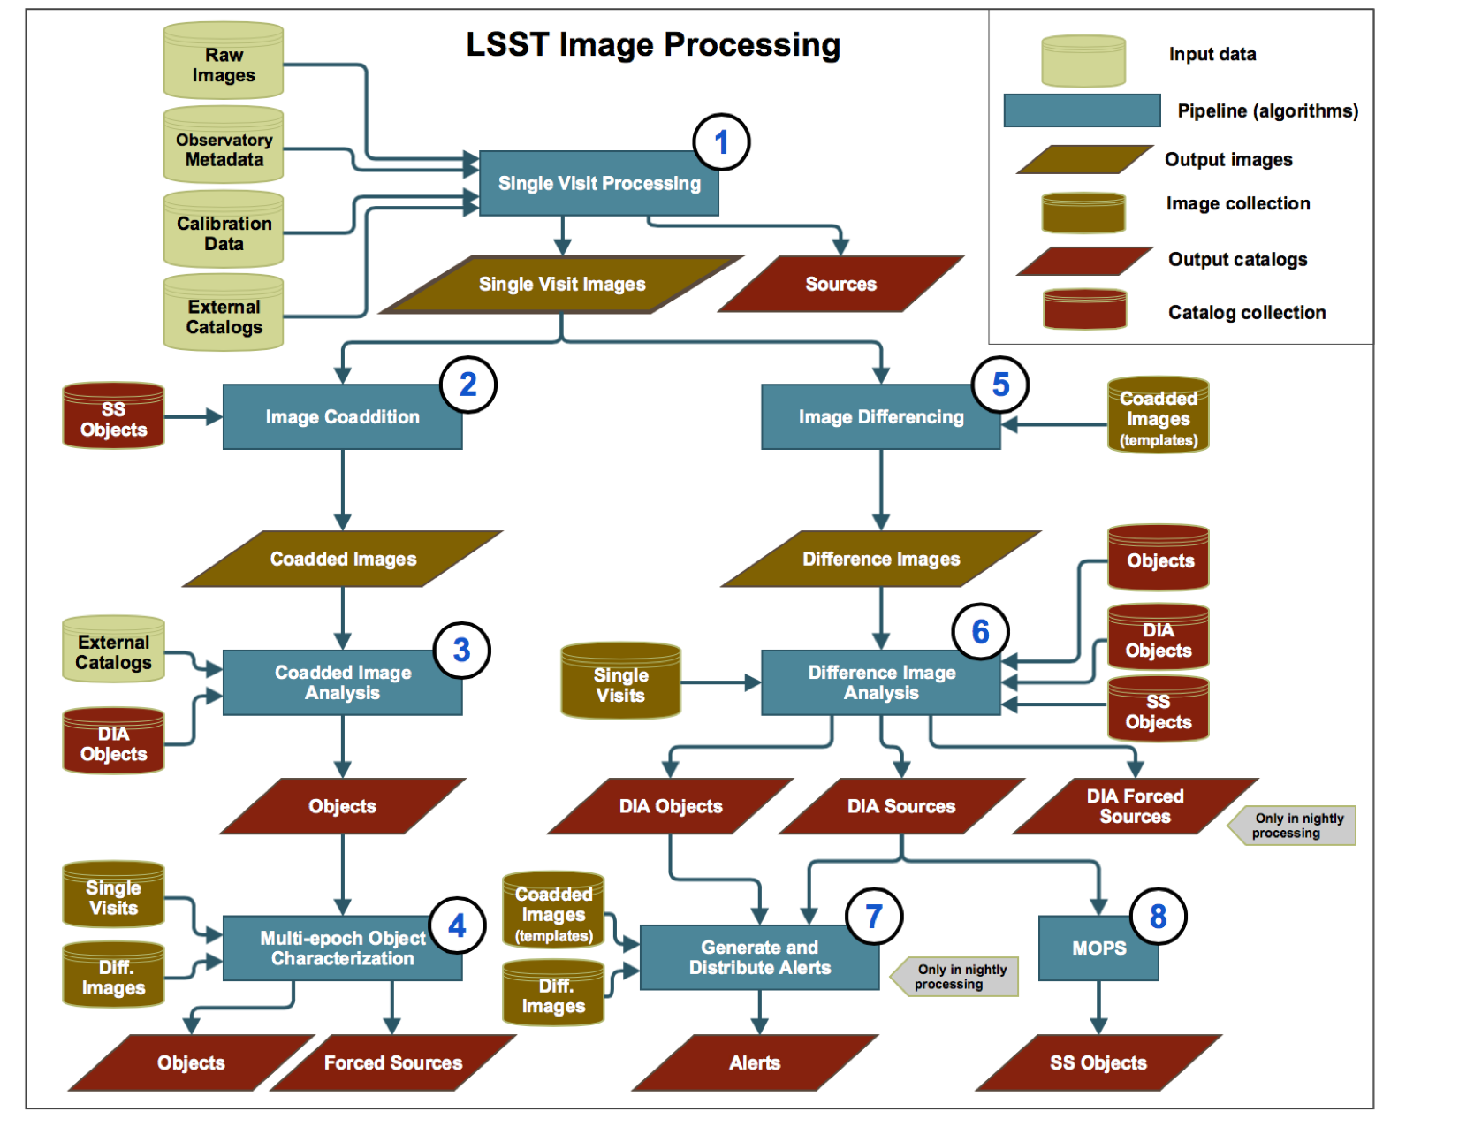


Software: the “second” LSST instrument
yearly
daily

Slide 19
DM is highly geographically distributed

Slide 20
Documentation and communication are important!
How the customer explained it
How the Project Leader understood it
How the Analyst designed it
How the Programmer wrote it
How the Business Consultant described it
How the project was documented
What Operations Installed
How the customer was billed
How it was supported
What the customer really needed

Slide 21
DM Top-level Document Tree

Slide 22
DM Verification Plan

Slide 23
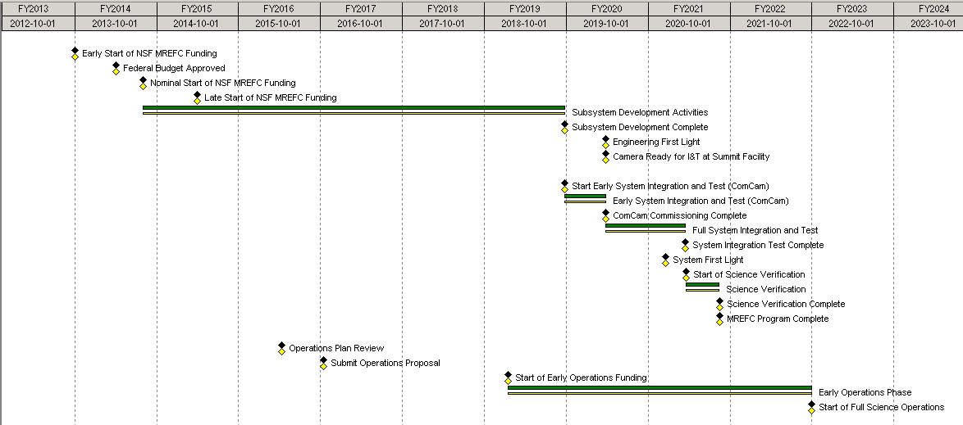
Integrated Master Schedule: Construction to Operations
Start Early Commissioning with ComCam
Install Camera
Science Verification
Early Completion
Adjust Start for 1 August and Transition to MREFC
Operations Review
April 1, 2019 Early Ops Start
13 Mo Contingency

Slide 24
Main management methods for ensuring progress
milestones: need to be verifiable so that schedule slips can be detected (e.g. milestone trend analysis)
reviews: need to be conducted honestly so that problems can be uncovered in timely manner (often external)
requirements management (change control)
while paying due attention to:
- cost and schedule management
- risk management
ensuring adequate information flow
Developing timelines (schedule) is difficult in general, very difficult with software projects, and especially difficult when new algorithms have to be developed (often similar to a research project with an uncertain outcome).
DISCUSSION: how can we assure that all parts of the project are aware when something is changed?

Slide 25
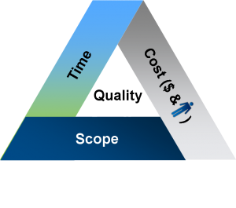
Scope - Schedule - Budget Tradeoffs
If progress is lacking, one or more
actions can be taken:
- increase resources (beware of Brooks Law)
- lengthen schedule
- descope
- strengthen or replace team leadership
- cancel the project (if possible, or start again)
https://en.wikipedia.org/wiki/Brooks%27s_law
Adding people to a late software project
makes it even later...

Slide 26
Scope - Schedule - Budget Tradeoffs
NASA FBC TASK FINAL REPORT
https://mars.jpl.nasa.gov/msp98/misc/fbctask.pdf

Slide 27
Scope - Schedule - Budget Tradeoffs
Hanlon's razor: "never assume malice when stupidity will suffice"

Slide 28
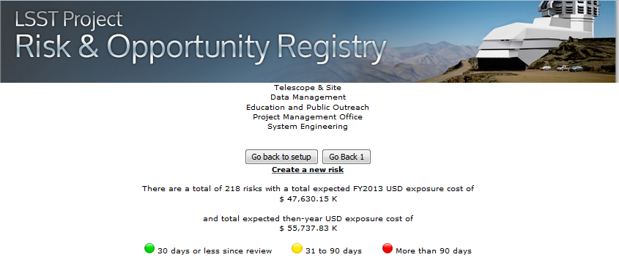
Risk Management Process
Design and Development Phase organized around traditional pre/post mitigation metrics
For Construction all mitigation steps programmed into plan
Focus for Register was exposure and on-going monitoring
Use online tool for consistency and remote collaboration
DISCUSSION: what is the greatest risk to you getting your Ph.D?

Slide 29
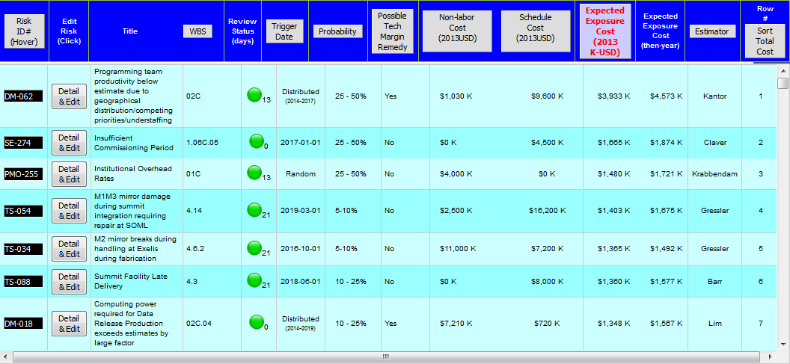
Risk Register Dashboard reveals Summary Data
Tool is central data base for assessment / impact / response plan
Organized for monthly risk meeting

Slide 30
Contingency Management
Technical
Budget
Schedule
Scope

Slide 31
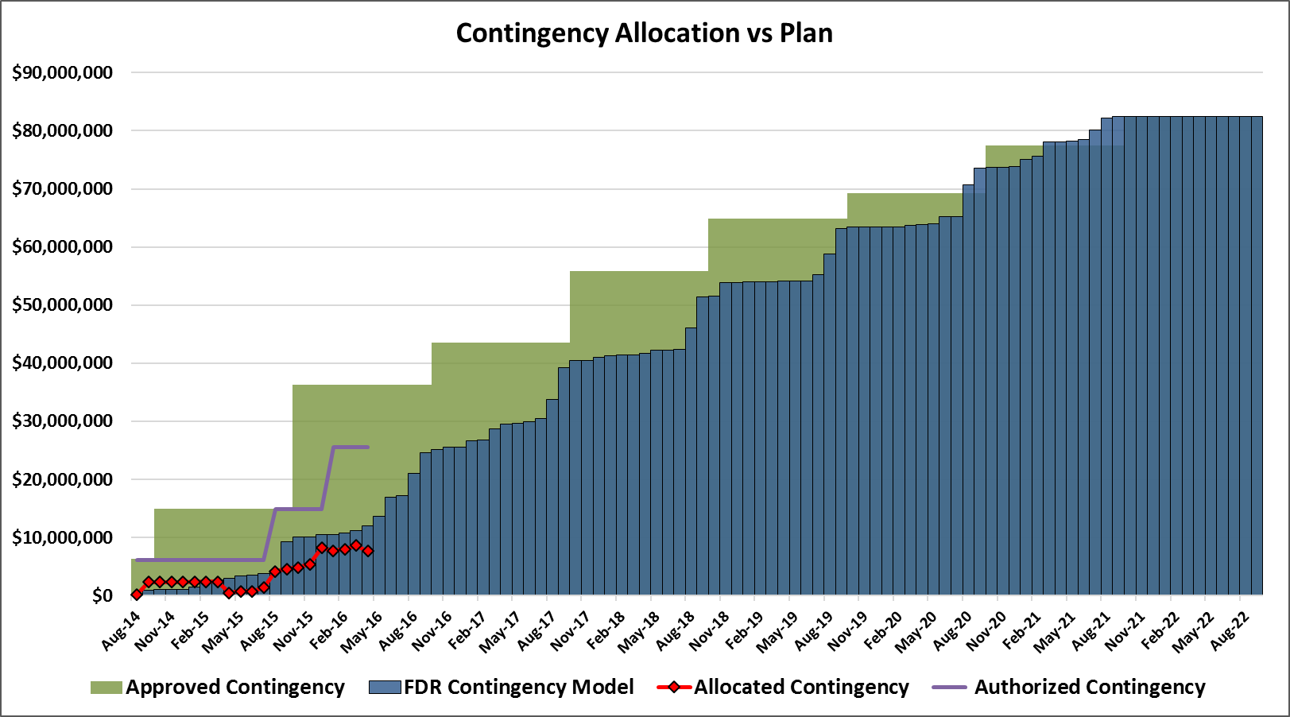
Contingency Actual Use versus Predictions
Activity Based Contingency assessed by Technical , Cost, Schedule “Risk Factors” applied to each activity in Plan

Slide 32
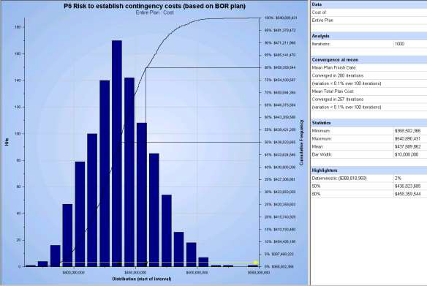
Cost Results of Monte Carlo Assessment
90% confidence that $82.4M contingency is sufficient

Slide 33
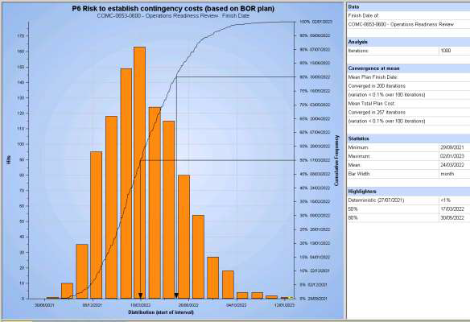
Schedule Results of Monte Carlo Assessment
90% confidence that 12 months contingency is sufficient

Slide 34
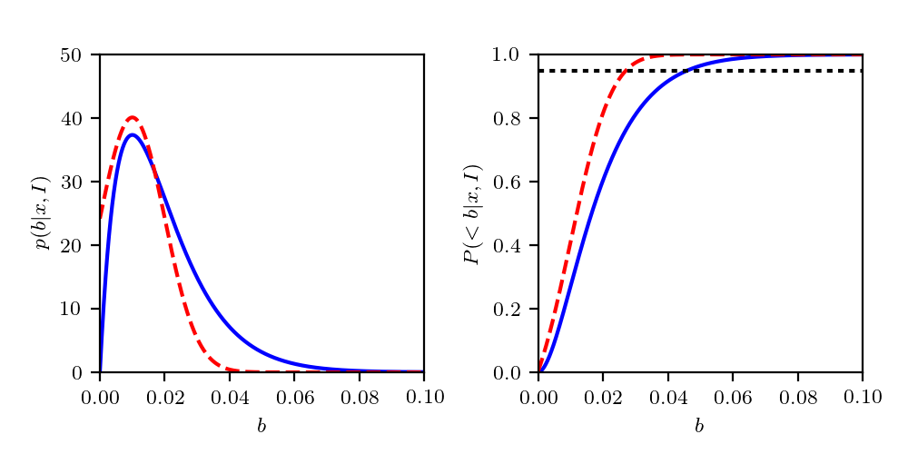
A comment about Monte Carlo risk analysis
It is very hard to treat rare events, both because data are scarce and because statistical analysis needs a lot of care.
For example, what was the probability that Rubin primary/tertiary mirror would be broken on its way from Arizona to Chile?
For the sake of argument, let’s assume that n=100 observatories were built, and that the primary mirror was broken k=1 times. Monte Carlo analysis would assume that for this risk, p = 1/100 = 0.01
But using astroML code
(fig. 5.9), we can show
that the 95% confidence
limit is ~0.05 - about
five times as large!
FYI: the blue is the exact
Poisson-based result and
the red is Gauss approx.
DISCUSSION: what about k=10, n=1000?
Expectation
value is ~0.02!
Twice as large
as ML value!

Slide 35
A comment about Monte Carlo risk analysis
DISCUSSION: what about k=10, n=1000?
Expectation and ML values
are similar: ~0.01
The posterior mean is
<b> = (k+1)/(n+2), see
https://johncarlosbaez.wordpress.com/2011/08/19/bayesian-computations-of-expected-utility/
Expectation
value is ~0.02!
Twice as large
as ML value!
k=10, n=100:
expectation and
ML values are
similar (~0.1), so need large k!

Slide 36
A comment about Monte Carlo risk analysis
If a low-probability event has probability p, then the sample
size from which it was estimated must have n at least as large
as 1/p (that is, k must have been at least 1). For example, if
p = 0.001, then n >= 1000.
If a much larger sample is implausible, then k must have been
very small and these effects must be accounted for in the analysis!
In other words, we must take into account the inherent uncertainty in our estimate of p !!!
Expectation
value is ~0.02!
Twice as large
as ML value!
k=1, n=100:

Slide 37
A few comments about team meetings (including zoom)
Preparation:
- announce the date early enough
- prepare agenda, circulate materials if needed
- order agenda topics according to importance and urgency
- remind those with outstanding action items
During the meeting:
- ensure broad participation (especially by younger colleagues, and taking into account many other factors)
- stick to the agenda as much as possible, beware of divergence
- set topic schedules according to needs, with a broad buy-in (remember contingency!)
- record agreed action items, with responsible people and delivery due dates
After party:
- circulate minutes (with action items, etc) in timely manner
- do follow up of action items, including milestone reminders etc
DISCUSSION: have you ever participated in an inefficient meeting?

Slide 38
Summary: Field guide to efficient project management
1) Compose strong teams by matching tasks to (people’s) skills and motivation. Carefully define top roles. Remember the Apollo Syndrome.
2) Make sure everyone understands their task, resources and schedule. Keep reminding them. Distinguish the project goals from individual agendas.
3) Carefully track and guard scope, budget, and schedule. You can’t have “faster, better, cheaper”. If you are lucky, you can have two of those. Beware especially of the scope creep in science projects. Don’t assign scope/tasks without an adequate increase in budget and/or schedule.
4) Maintain meaningful risk register. Don’t believe Monte Carlo too much! "It’s hard to make predictions, especially about the future.”
5) Never stop caring for and motivating your team - it’s the people who do the work! Ensure that people feel ownership of and pride in their work, and that they receive adequate credit for their accomplishments. Never ever criticize or ridicule your team members in public!
DISCUSSION: would you like to be a project leader/manager? Why or why not?

Slide 39
DISCUSSION
Are top leaders and managers born or trained? Nature or nurture?
How can one deal with capable but often disruptive individuals?
Can we dream of projects that take more than one career length?
How can we assure that all parts of the project are aware when something is changed?
Monte Carlo: difference between the most probable and expected values
What is the greatest risk to you getting your Ph.D?
Is it harder to do and manage hardware, or software?
Have you ever participated in an inefficient meeting?
Would you like to be a project leader/manager? Why or why not?

